Slide 1


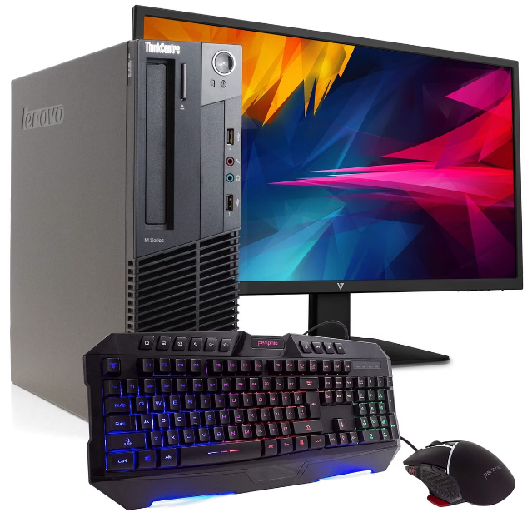
Introduction to Computers
Computers are versatile machines that have revolutionized the way we live, work, and communicate. They process data, execute instructions, and enable us to access a vast amount of information at our fingertips. Mastering the fundamentals of computers is essential in today's digital world.
pj

Slide 2
Hardware Components
Processor
Memory
Storage Devices
The brain of the computer, responsible for executing instructions and performing calculations.
Stores data and programs for quick access by the processor.
Permanently store data, such as hard drives, solid-state drives, and optical discs.

Slide 3

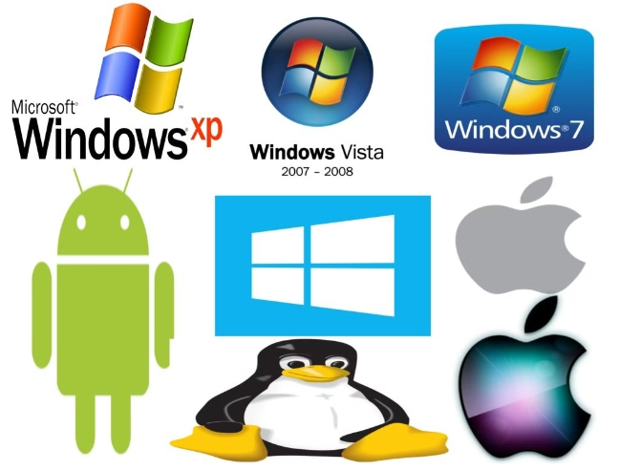
Software and Operating Systems
1
System Software
Manages the computer's hardware and provides a platform for running application software.
2
Application Software
Designed to perform specific tasks, such as word processing, spreadsheets, or media players.
3
Operating Systems
The core software that controls the computer's resources and user interface.

Slide 4

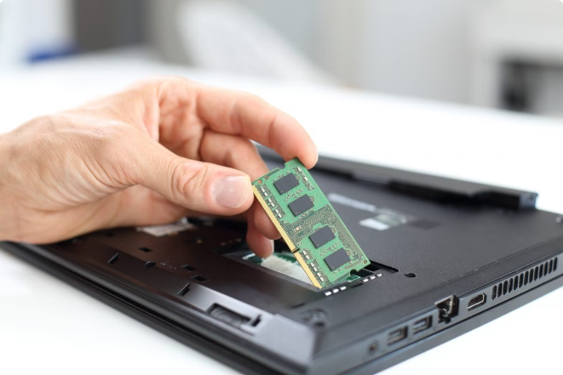
Data Storage and Memory
RAM
Provides temporary storage for data and programs currently in use by the processor.
ROM
Stores the basic instructions needed to start the computer and load the operating system.
Hard Drives
Offer large, permanent storage capacity for documents, files, and applications.
Solid-State Drives
Faster and more reliable than traditional hard drives, with no moving parts.

Slide 5


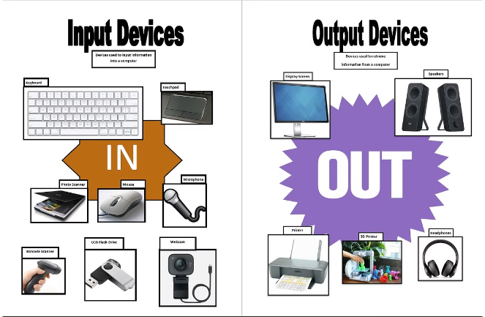



Input and Output Devices
Keyboard
Allows users to input text and commands.
Mouse
Provides a way to interact with the graphical user interface.
Monitor
Displays output, such as text, images, and video.
Printer
Transforms digital information into physical, printed documents.

Slide 6
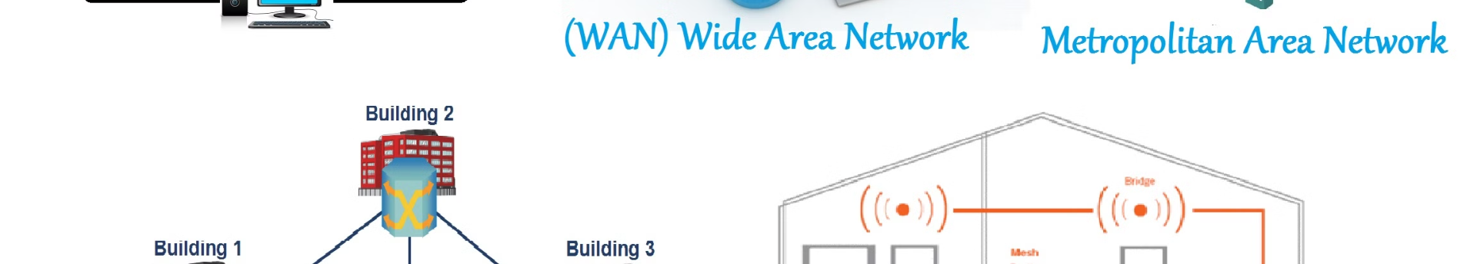



Computer Networks and the Internet
Local Area Network (LAN)
Wide Area Network (WAN)
The Internet
Connects computers and devices within a small geographic area, such as a home or office.
Connects LANs and devices over a larger geographic area, such as across cities or countries.
A global network of interconnected networks that allows for the exchange of information and communication worldwide.

Slide 7

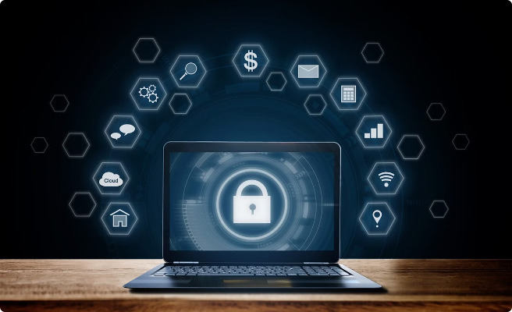
Computer Security and Privacy
1
Antivirus Software
Protects against malware and other cyber threats that can compromise system security.
2
Firewalls
Monitor and control incoming and outgoing network traffic to prevent unauthorized access.
3
Encryption
Secures data by converting it into a coded format that can only be accessed by authorized users.
4
Backups
Ensure important data can be restored in the event of a system failure or data loss.

Slide 8
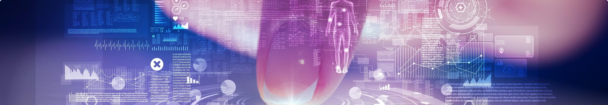
Future Trends in Computing
Artificial Intelligence
Machines that can learn, reason, and perform tasks autonomously.
Internet of Things (IoT)
The interconnection of everyday devices and appliances to the internet.
Quantum Computing
Harnessing the principles of quantum mechanics to perform complex calculations.
5G and Beyond
Faster, more reliable, and more ubiquitous wireless communication networks.

